Slide 1


School of Mechanical Engineering
Course Code: Course Name: Engineering Graphics
BME01T1001
Multiview Drawing Orthographic Projection
Ist Year
Ist Semester
Galgotias University
2020-21
Faculty Name: K.S.Srikanth Program Name: B.Tech

Slide 2
Prerequisite/Recapitulations
Theory of Projection
Concept of views
Projection lines

Slide 3
Objectives
To understand the meaning of multiview drawing
To understand the concept of orthographic projection
To understand how to draw different views of a given object

Slide 4
Introduction
A multiview drawing is one that shows two or more two-dimensional views of a three-dimensional object.
Multiview drawings provide the shape description of an object. When combined with dimensions, multiview drawings serve as the main form of communication between designers and manufacturers.

Slide 5
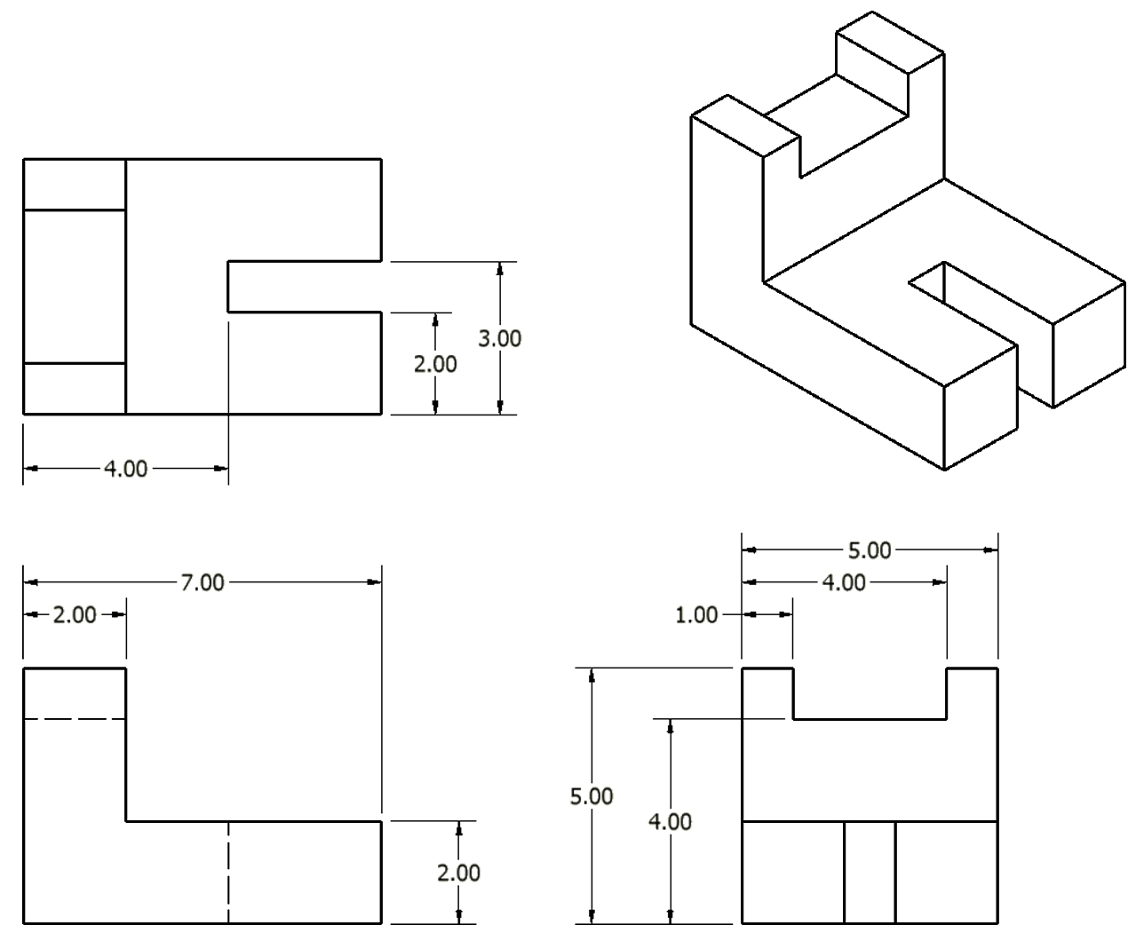
Introduction

Slide 6
Introduction
All three-dimensional objects have width, height, and depth.
Width is associated with an object’s side-to-side dimension.
Height is the measure of an object from top-to-bottom.
Depth is associated with front-to-back distance.

Slide 7
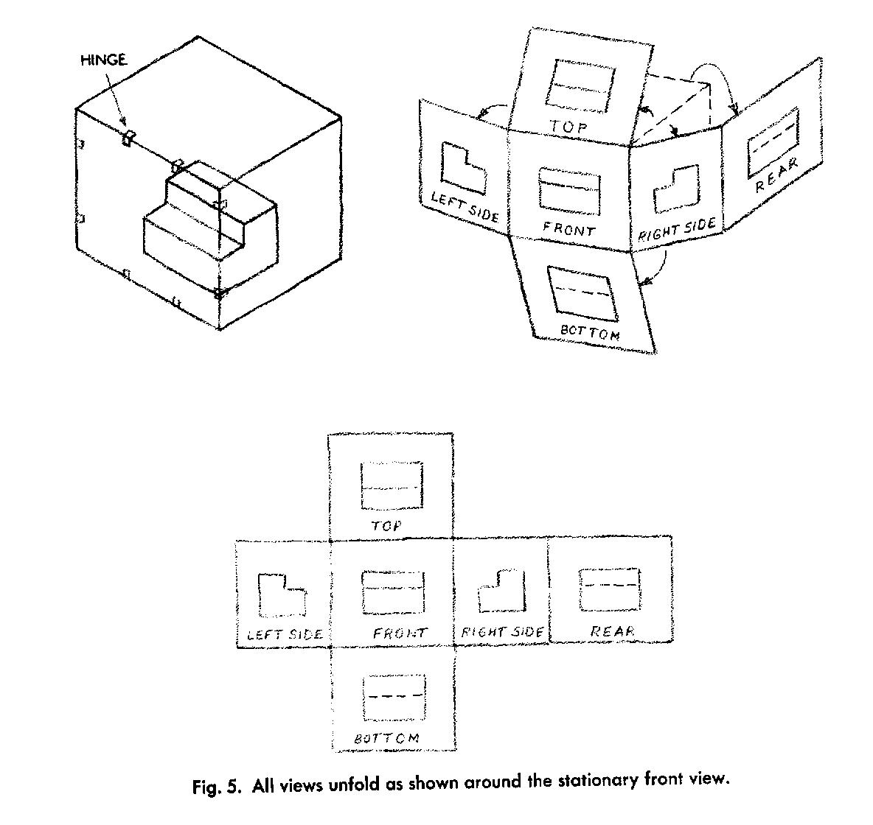
Glass Box – 6 views of an object
Glass Box
Unfolding the Glass Box
All the views unfold as shown around the stationary front view.
6 views of an object – 2 D

Slide 8
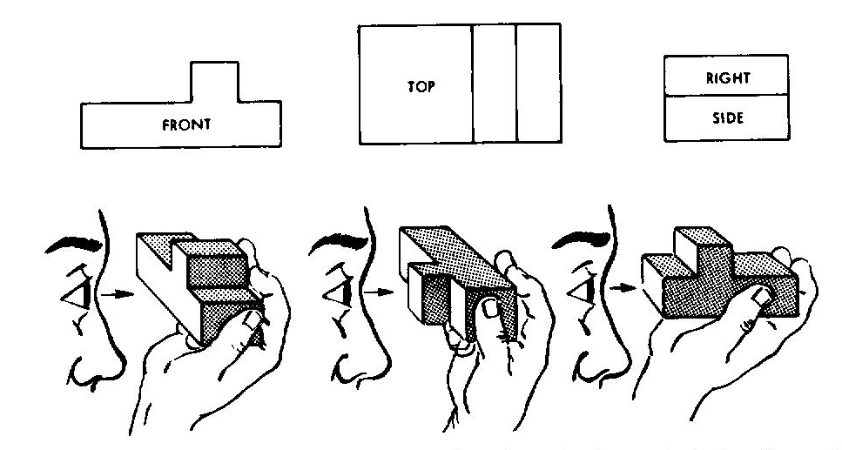
Viewing the object-Visualizing views
Notice how each view appears when looking directly at that view of the object.

Slide 9
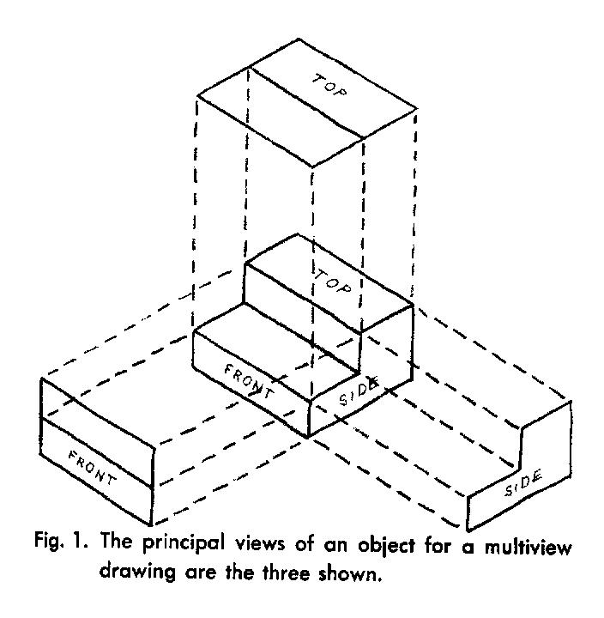
3 View Drawing Most Commonly Used Views
Front View
Top View
Side View
Color code can help to visualize

Slide 10
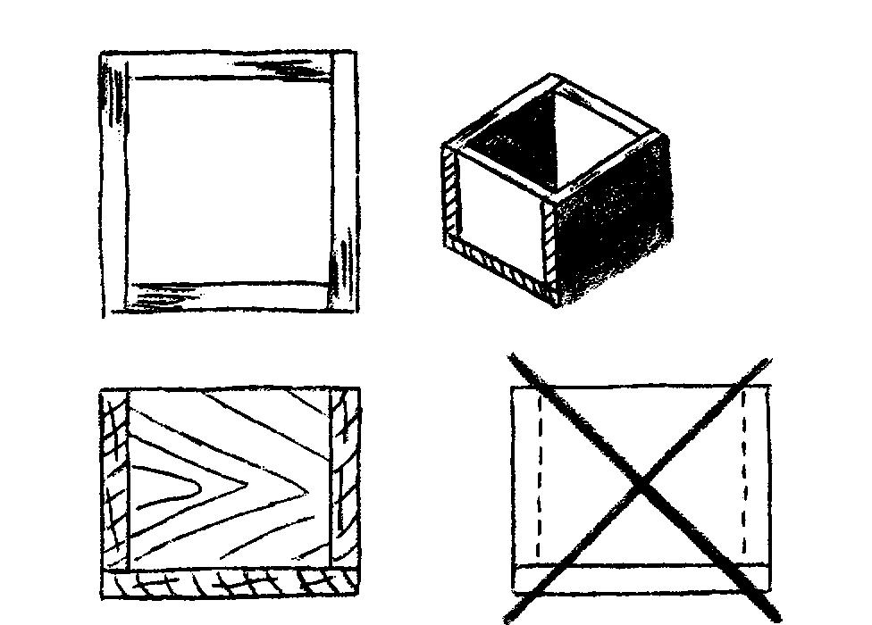
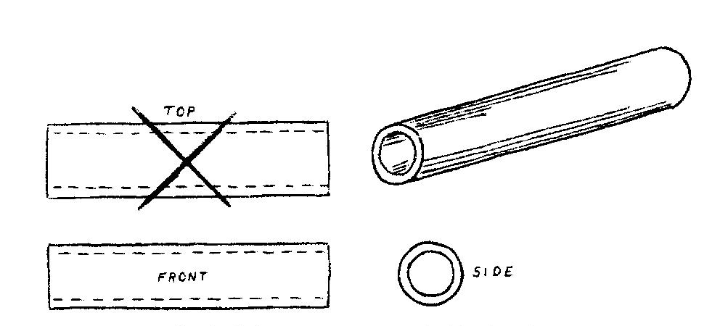
Duplicate Views are Unnecessary
Only 2 views are needed for these examples

Slide 11
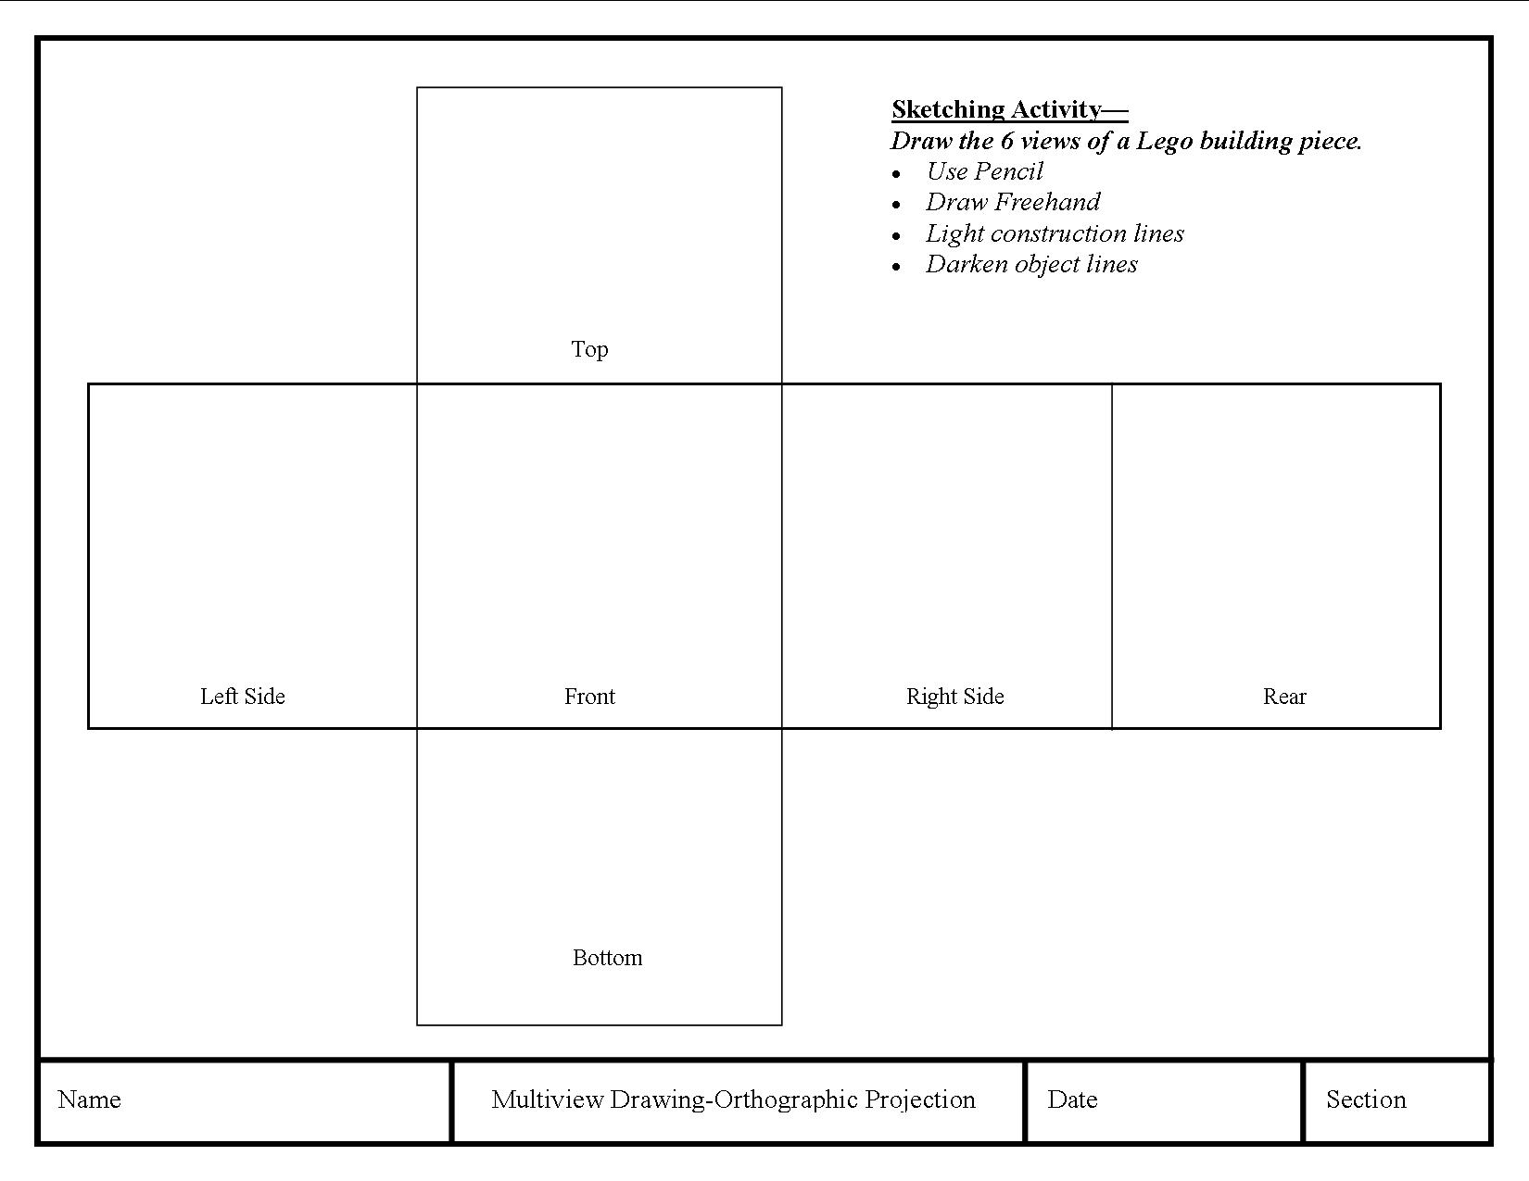
Sketching Activity Lego Part – Multiview Drawing

Slide 12

Animation Video

Slide 13
Pictorial Drawing
A pictorial drawing
Shows the object as it appears, not as it really is.
Holes in the base appear as ellipses, not as true circles.
Is a drawing.
Shows an object as it would appear in a photograph.
Shows the way an object looks, in general.
It does not show, the exact forms and relationships of the parts that make up the object.
Photograph
Pictorial Drawing

Slide 14
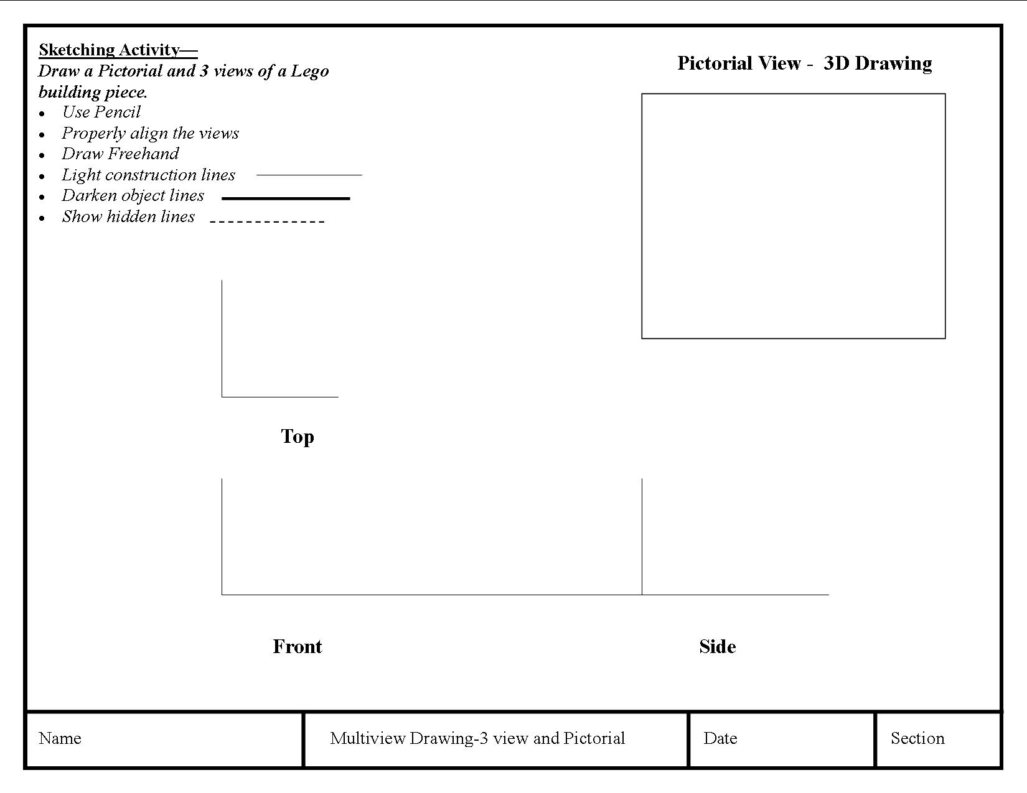
Multiview Drawing–3 view and Pictorial

Slide 15
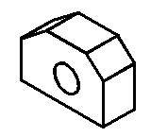
Unfolding the box produces an arrangement of the six views

Slide 16
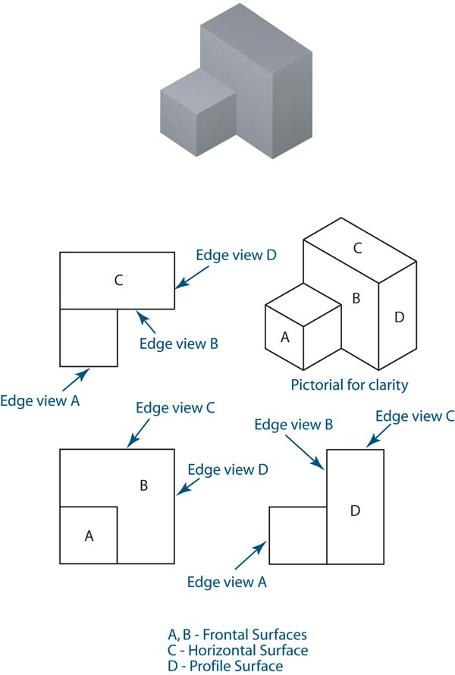
View Alignments
In orthographic projections, the views are aligned such that each point on the object is lined up with itself all three views.
Each view shows two dimensions
Top: width and depth
Front: height and width
Right side: height and depth
Width
Width
B
A
Depth
B
Depth
A
B
B
Height
A
A

Slide 18
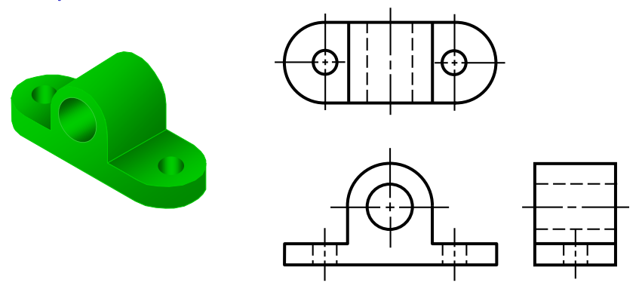

Slide 19
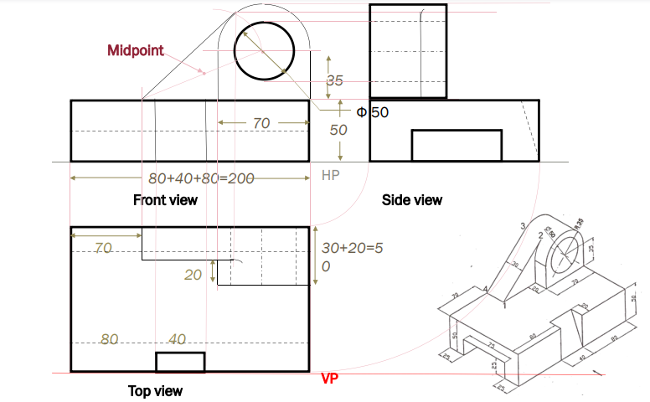
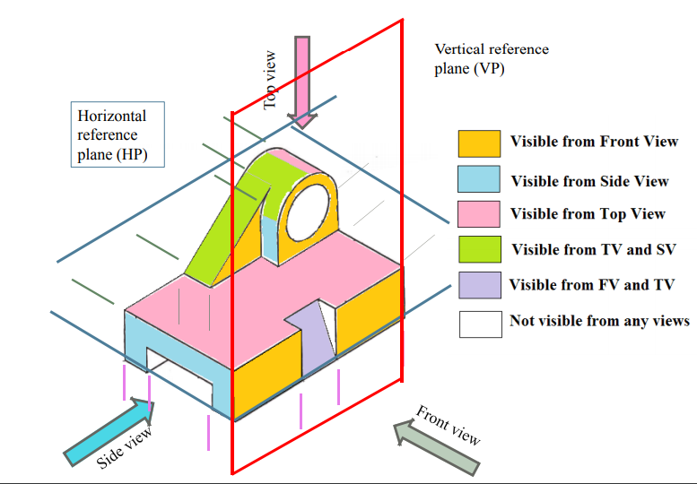
Summary

Slide 20
Reference
http://www.iitg.ac.in/kpmech/ME111-2016/ORTHOGRAPHIC%20PROJECTIONS-1%20(2016).pdf
https://www.fd.cvut.cz/department/k611/PEDAGOG/K611GM_A_soubory/4_Multiview_Drawing.pdf
https://en.wikipedia.org/wiki/Multiview_projection
ND Bhatt Book
NPTEL

Slide 21
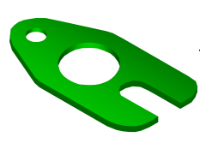
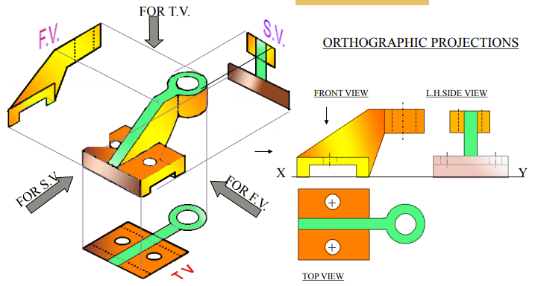
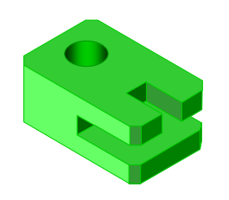
Thank You

